Slide 1
Course Code:CSC402A Course Title: Web Architecture and Application Development
Course Leader:
Kishore S.M.
kishore.cs.et@msruas.ac.in

Slide 2
Objectives
After completing this lecture, the student will be able to
Describe Interaction oriented architecture
Analyze Model-View-Controller
Analyze Presentation-Abstraction-Control (PAC)

Slide 3
Contents
Model-View-Controller
Presentation-Abstraction-Control (PAC)

Slide 4
Interaction Oriented Architectures
The interaction-oriented software architecture decomposes the system into three major partitions: data module, control module, and view presentation module.
Data Module: The data module provides the data abstraction and all core business logic on data processing.
View presentation module: The view presentation module is responsible for visual or audio data output presentation and may also provide user input interface when necessary.
Control Module: The control module determines the flow of control involving view selections, communications between modules, job dispatching, and certain data initialization and system configuration actions

Slide 5

Interaction Oriented Architectures
Model-View-Controller
MVC architecture is widely adopted for web server site interactive application design such as online shopping, surveys, student registration, and many other interactive service systems
MVC architecture is specifically used in applications where user interfaces are prone to data changes
MVC also typically supports “look and feel” features in GUI systems

Slide 6
Interaction Oriented Architectures
MVC-1
The MVC-I is a simple version of MVC architecture where the system is simply decomposed into two subsystems: The Controller-View and the Model.
Controller-View
Controller-view takes care of input and output processing and their interfaces; the Model module copes with all core functionality and the data.
Model
The Model module notifies the Controller-View module of any data changes so that any graphics data display will be changed accordingly; the controller also takes appropriate action upon the changes.

Slide 7
Interaction Oriented Architectures
Let's look at a simple GUI example designed in MVC-I
The View has a GUI interface with two text fields; the user enters a new number in one of the text fields and the accumulated summation is displayed in the other
The summation is held in the Model module
The Model provides all business logics including all getter and setter methods
Whenever the data in the Model is updated, it will notify the registered GUI components of changes
Then the GUI components will update their displays. This is why we say that the data in the Model of MVC architecture is active rather than passive.

Slide 8
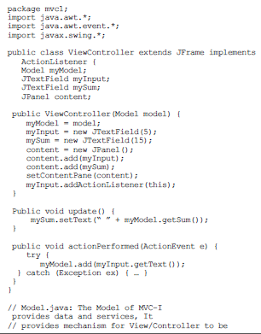
Interaction Oriented Architectures

Slide 9
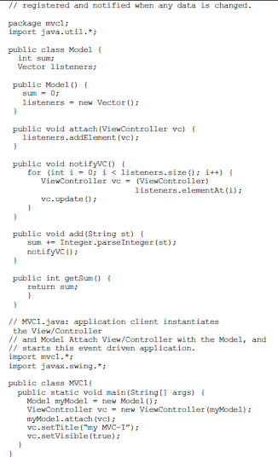
Interaction Oriented Architectures

Slide 10
Interaction Oriented Architectures
MVC-2
The MVC-2 architecture is a further development from the MVC-I architecture
The Model module provides all core functionality and data supported by a database. The View module displays the data while the Controller module takes input requests, validates input data, initiates the Model and the View and their connection, and dispatches tasks
The Controller and the View register with the Model module. Whenever the data in the Model module is changed, the View module and the Controller module are notified of the changes

Slide 11
Interaction Oriented Architectures
MVC-2
The MVC-2 architecture is a further development from the MVC-I architecture
The Model module provides all core functionality and data supported by a database. The View module displays the data while the Controller module takes input requests, validates input data, initiates the Model and the View and their connection, and dispatches tasks
The Controller and the View register with the Model module. Whenever the data in the Model module is changed, the View module and the Controller module are notified of the changes
In MVC-II architecture, the View module and the Controller module are separate

Slide 12
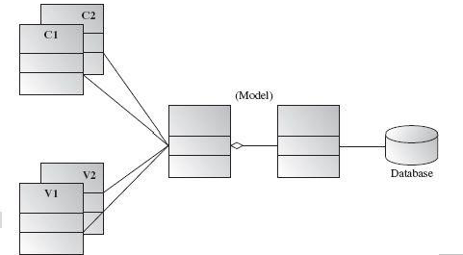
Interaction Oriented Architectures
MVC-2

Slide 13
Interaction Oriented Architectures
Applicable domains of MVC architecture
• Interactive applications where multiple views are needed for a single data model and the interfaces are prone to frequent data changes
• Applications with clear divisions between controller, view, and data modules so that different professionals can be assigned to work on different aspects of such applications concurrently

Slide 14
Interaction Oriented Architectures
Benefits:
• Many MVC vendor framework toolkits are available
• Multiple views synchronized with same data model
• Easy to change or plug in new interface views, allowing updating of interface views with new technologies without overhauling the rest of the system
• Very effective for developments if graphics, programming, and database development professionals are working in a team in a designed project

Slide 15
Interaction Oriented Architectures
Limitations:
• Not suitable for agent-oriented applications such as interactive mobile and robotics applications
• Multiple pairs of controllers and views based on the same data model make any data model change expensive
• The division between the View and the Controller is not clear in some cases

Slide 16
Interaction Oriented Architectures
Presentation-Abstraction-Control (PAC)
The PAC architecture is similar to MVC but with some important differences. PAC was developed from MVC to support the application requirement of multiple agents in addition to interactive requirements.
In PAC, the system is decomposed into a hierarchy of cooperating agents
Each agent has three components (Presentation, Abstraction, and Control)
The Control component in each agent is in charge of communications with other agents

Slide 17
Interaction Oriented Architectures
The top-level agent provides core data and business logics
The bottom-level agents provide detailed data and presentations
A middle-level agent may coordinate low-level agents
Within each agent, there are no direct connections between the abstraction component and Presentation component
The PACs three components concepts are applied to all concrete subsystem architectures
PAC is suitable for any distributed system where all the agents are distantly distributed and each agent has its own functionalities with data and interactive interface

Slide 18
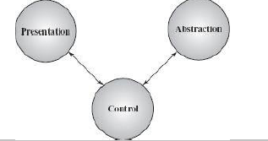
Interaction Oriented Architectures
Below diagram shows a diagram for a single agent in a PAC
design

Slide 19
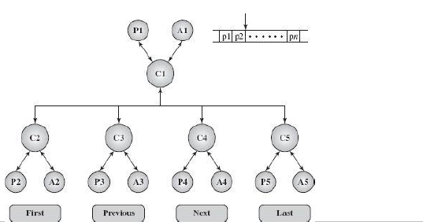
Interaction Oriented Architectures
Below diagram shows a diagram for a multiple agent in a PAC
design

Slide 20
Interaction Oriented Architectures
Applicable domains of the PAC architecture:
• Suitable for an interactive system where the system can be divided into many cooperating agents in a hierarchical manner and each agent has its own specific assigned job
• Suitable when the coupling among the agents is expected to be loose so that changes on an agent do not affect others
Benefits :
• Support of multitasking and multiviewing
• Support agent reusability and extensibility
• Easy to plug in new agent or replace an existing one
• Support for concurrency where multiple agents run in parallel in different threads or on different devices or computers

Slide 21
Interaction Oriented Architectures
Limitations:
• Extra time lost due to the control bridge between presentation and abstraction and the communication of controls among agents
• Difficult to determine the correct number of the agents due to the loose coupling and high independence between agents
• Complete separation of presentation and abstraction by control in each agent generates development complexity since
communications between agents only take place between the controls of agents

Slide 22
Summary
MVC architecture is specifically used in applications where user interfaces are prone to data changes
PAC was developed from MVC to support the application requirement of multiple agents in addition to interactive requirements

